Slide 1
Ce
Au (100 nm)
Triple Cation
Perovskite Cells
Ce
Au (100 nm)
Ce
MoOx (15 nm)
Ce
MoOx (15 nm)
Ce
SPIRO (150 nm)
Ce
SPIRO (150 nm)
Ce
Triple Cation (500 nm)
Ce
Triple Cation (500 nm)
Ce
SnO2 (50 nm)
Ce
SnO2 (50 nm)
Ce
ITO (150 nm)
Ce
ITO (150 nm)
Ce
Ce-Borosilicate (250 μm)
Ce
Fused Silica (1000 μm)
Ce
Al (100 nm)
Ce
Al (100 nm)
Ce
MoOx (15 nm)
Ce
MoOx (15 nm)
Ce
PTAA (30 nm)
Ce
SPIRO (150 nm)
Ce
Triple Cation (500 nm)
Ce
Triple Cation (500 nm)
Ce
SnO2 (50 nm)
Ce
SnO2 (50 nm)
Ce
ITO (150 nm)
Ce
ITO (150 nm)
Ce
Soda Lime Glass (1000 μm)
Ce
Soda Lime Glass (1000 μm)

Slide 2
Ce
Al (100 nm)
All-Inorganic
Perovskite Cells
Ce
Au (100 nm)
Ce
MoOx (15 nm)
Ce
MoOx (15 nm)
Ce
PTAA (30 nm)
Ce
SPIRO (150 nm)
Ce
CsPbI₂Br (250 nm)
Ce
CsPbI₂Br (250 nm)
Ce
SnO2 (50 nm)
Ce
SnO2 (50 nm)
Ce
ITO (150 nm)
Ce
ITO (150 nm)
Ce
Soda Lime Glass (1000 μm)
Ce
Ce-Borosilicate (250 μm)
Ce
Ce
Al (100 nm)
Au (100 nm)
Ce
Ce
MoOx (15 nm)
MoOx (15 nm)
Ce
Ce
SPIRO (150 nm)
SPIRO (150 nm)
Ce
Ce
CsPbI₂Br (250 nm)
CsPbI₂Br (250 nm)
Ce
Ce
SnO2 (50 nm)
SnO2 (50 nm)
Ce
Ce
ITO (150 nm)
ITO (150 nm)
Ce
Ce
Soda Lime Glass (1000 μm)
Fused Silica (1000 μm)

Slide 3
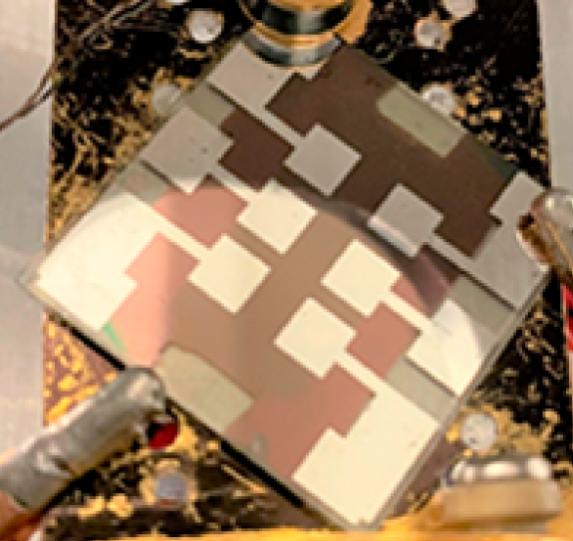
Electrode pattern on the solar cell

